Slide 1





Presentation
Mohamed Ali Abuella
mhdabuella@gmail.com

Slide 2
Motivation
Introduction
Presentation Outline
Research

Slide 3
Introduction
Mohamed Abuella
https://mohamedabuella.github.io
https://www.linkedin.com/in/mohamed-abuella/
About Me..
An electrical engineer by training, traditionally is interested in Mathematical and Computational Analysis, Modeling and Optimization, and who is recently passionate in Artificial Intelligence and Data-driven Analytics.
A researcher works to modernize the electric grid and optimize its integration of distributed energy resources by applying descriptive, predictive and prescriptive analytics.
His broader interest involves utilizing Artificial Intelligence to foster Sustainability.
An adaptative to work in a diverse environment for an interdisciplinary research.

Slide 4
Introduction
https://mohamedabuella.github.io/cv
To sum it up in a broad sense, let's imagine that.. If my professional development was a book, its title would be "Energy Systems Modeling and Analysis: Operation, Planning, and Integration.“
Thus, the chapters of this book would be as follows:
Ch.1 Fundamentals of Electrical Engineering. This chapter covers Instrumentation & Control, Basics of Power Electronics such as Diodes & Thyristors as rectifiers, (maneuvered by applying Laws of Physics). With getting hands-on electrical installation & wiring and maintenance of electrical control equipment at pumping stations.
Ch.2 Power Systems Analysis. It includes Power Flow and Faults Calculations, (applying Numerical Analysis methods, such as Newton methods, Differential eqs & Integrals, etc). Get hands-on some simulations of power systems and programmable logic controllers (PLC).
Ch.3 Optimal Power Flow (OPF) and Security-Constrained Economic Dispatch (SCED). It is considering renewables as well, specifically for wind energy resources at the transmission level, (applying Optimization techniques). Get hands-on more of modeling and analysis of power systems.
Ch.4 Optimize the Integration of Renewables into the Grid. Solar Power Modeling and Forecasting, (applying Descriptive, Predictive and Prescriptive Analytics, AI and ML techniques). Get hands-on data-driven analytics and become more familiar with conducting & publishing research.
Ch.5 Postdoctoral Researcher at the Center for Applied Intelligent Systems Research (CAISR) at Halmstad University, (Integrated Academy-Industry Collaboration, Applying AI techniques). Dig into research on AI for Sustainability.
Ch.6 Research Fellow at Northumbria University in HI ACT: Hydrogen Integration for Energy

Slide 5
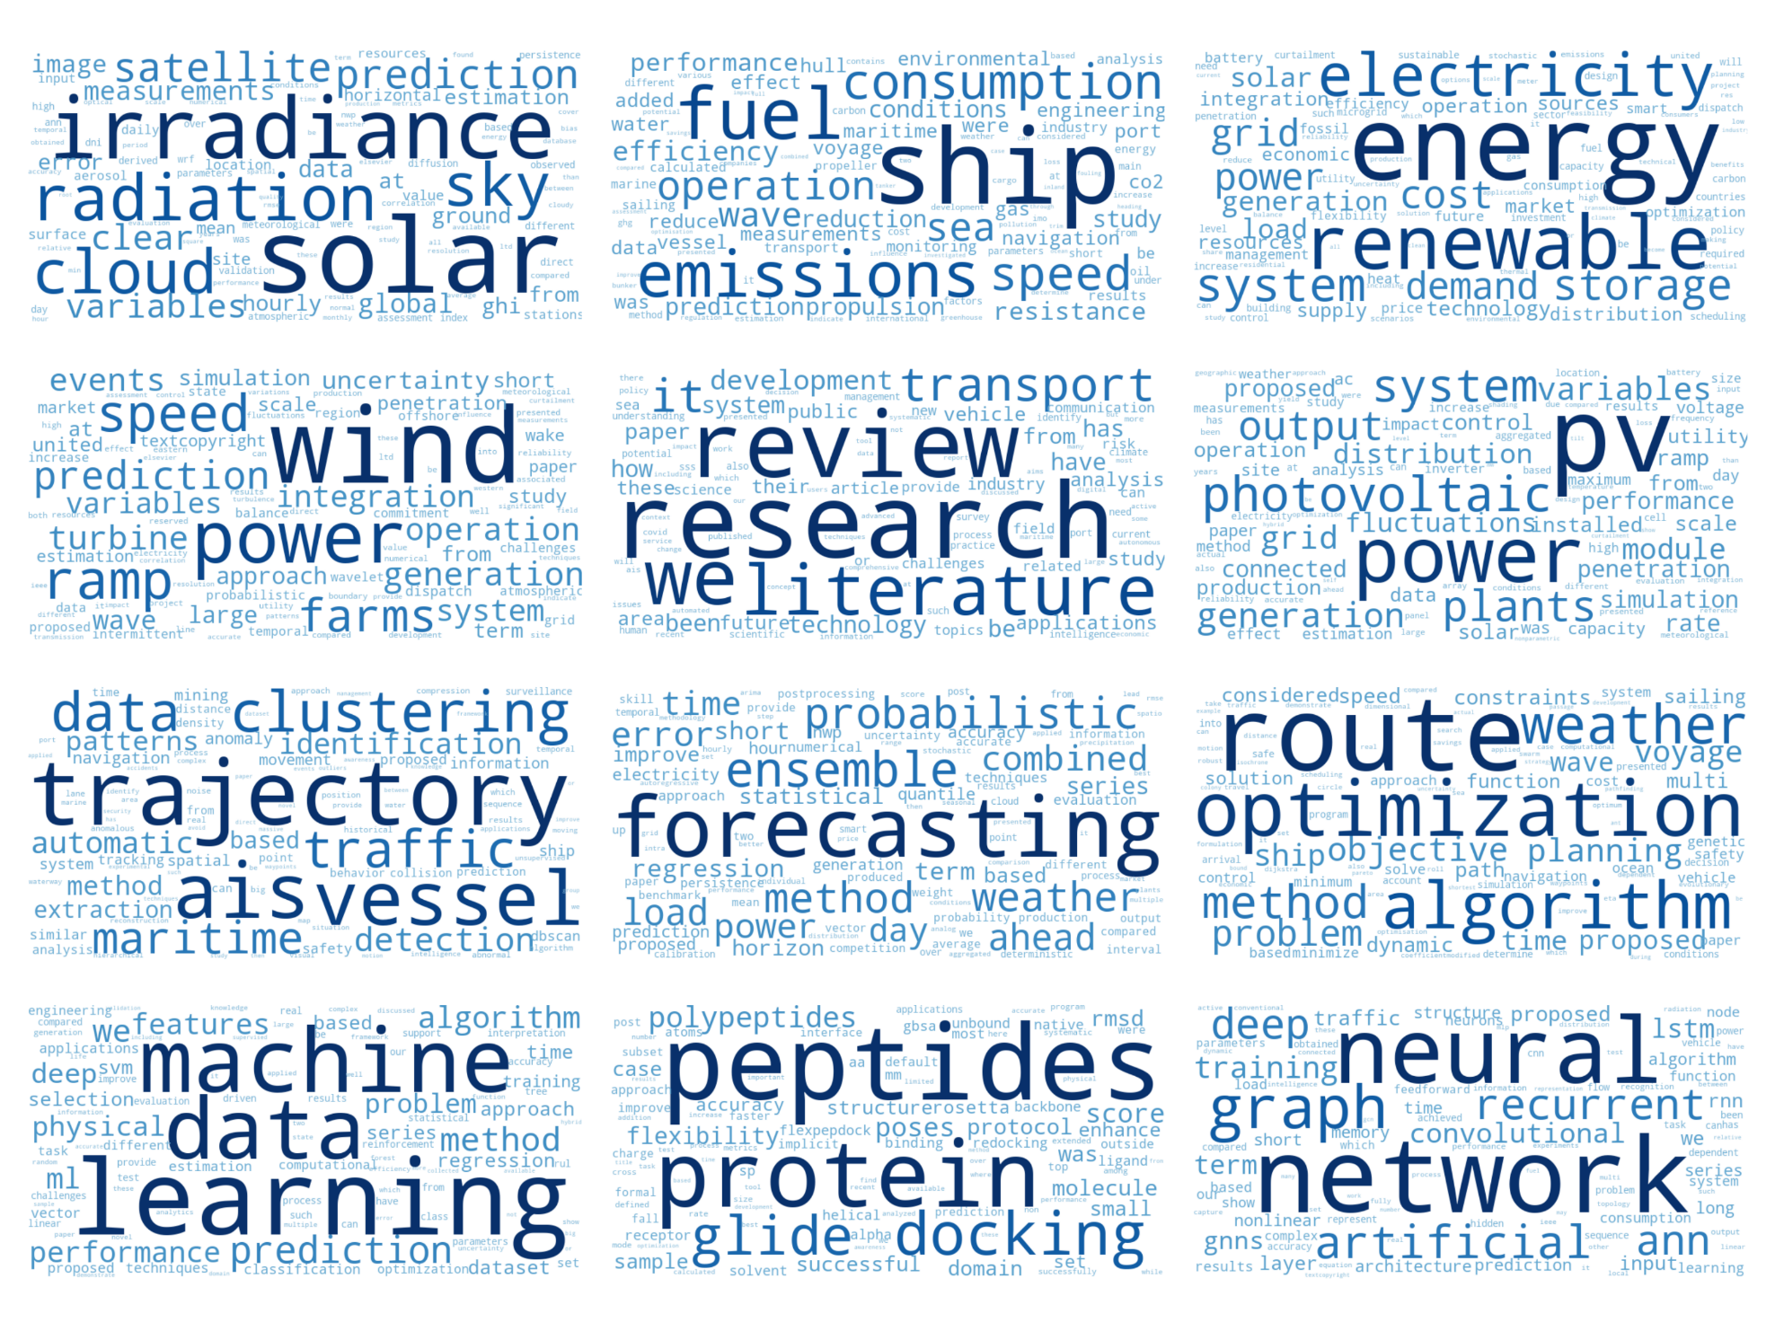
Introduction
In a nutshell, what I am often doing is finding the optimal & root values and curve fitting of nonlinear equations.
..But usually it is not as simple as that!
For more details, you may have a look at pdf copies of my CV and Cloud of Key Skills & Interests.

Slide 6
Introduction
What can I bring to the team..?
Transfer knowledge and skills to integrate the collaboration between academy and industry:
Energy Systems Modeling & Analysis, Optimization, AI, Geospatial Analysis.
Including Transportation and Maritime Systems.
Including Water and Wastewater experience
An adaptatively to diverse environment and flexibility to multidisciplinary research:
Study and work in Middle East (Libya): Engineering, Electricity, Water and Wastewater.
Study and work in North America (USA): Energy, Optimization, Statistics, AI.
Work in Europe (Sweden): Energy, Transportation, Maritime, AI.

Slide 7
Motivation
Professional Advancement
Get an opportunity to collaborate and work with the experts of the field.
To transfer, improve, and acquire knowledge and skills.
Personal Advancement
Better alignment with personal values and interests.
Better self-esteem.
Better financial security.

Slide 8
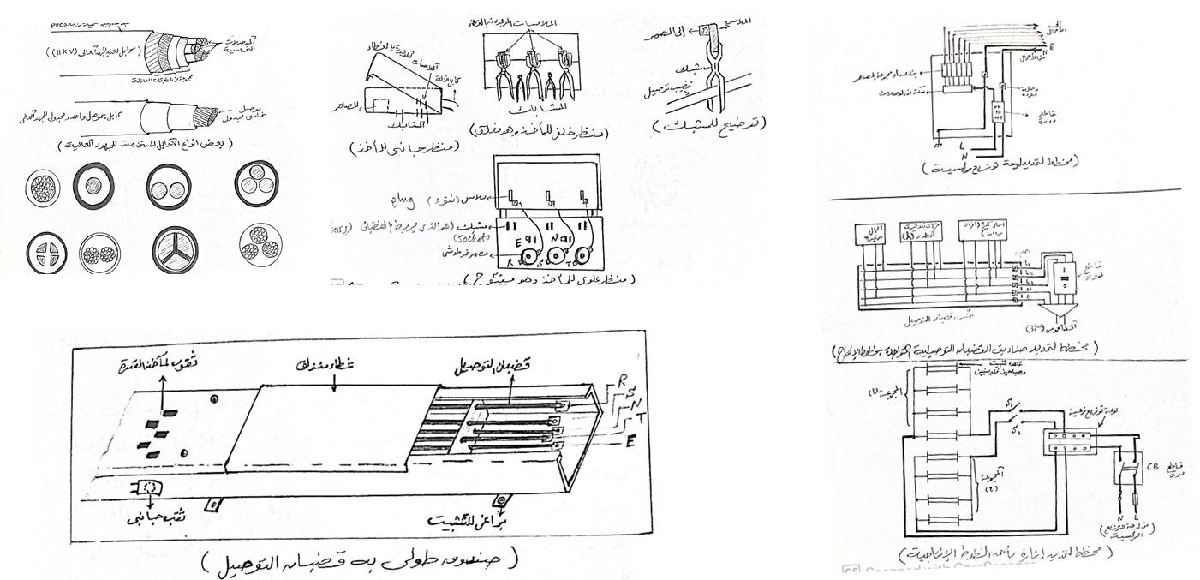
Research
Technical Report of Operation & Maintenance, Internship at Shoes Factory in Misurata, Libya
https://www.researchgate.net/publication/344772515_Technical_report_of_maintenance_and_operation_internship_at_shoes_factory_in_Misurata_Libya
Mohamed Abuella, 2000 at Higher Center of Poly-Profession, Misurata, Libya
Electrical Operation & Maintenance for fulfilling requirement of the Higher Diploma

Slide 9
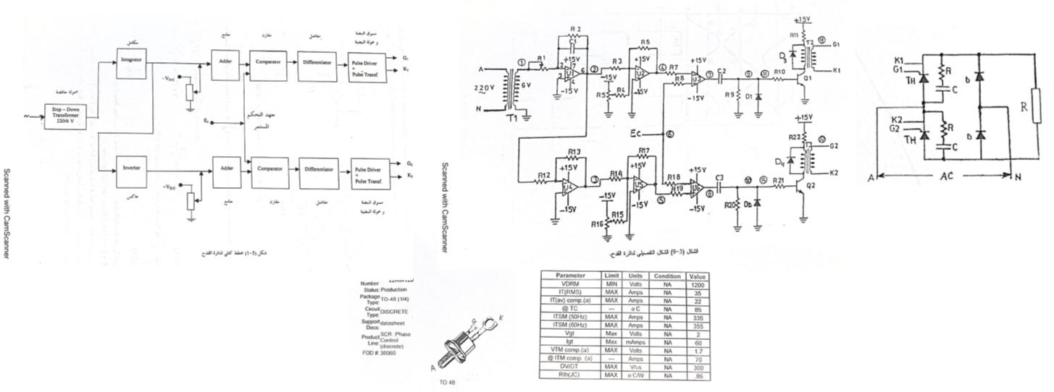
Research
Triggering Circuit for SCR Thyristors of an AC-DC Converter
https://www.researchgate.net/publication/277109663_Triggering_Circuit_for_SCR_Thyristors_of_an_AC-DC_Converter
Mohamed Abuella, Ali Mohamed, Al Sayed Hamady, Advisor: Safa Samarmad
Tech Diploma Project, 2001 at Higher Center of Poly-Profession, Misurata, Libya
Higher Diploma project was in Power Electronics area. Since the task of the project of three-members-group was to build a triggering electronic circuit for a rectification bridge of Thyristors
Acquired Expertise: Electrical Wiring & Installations, Maintenance & Operation

Slide 10

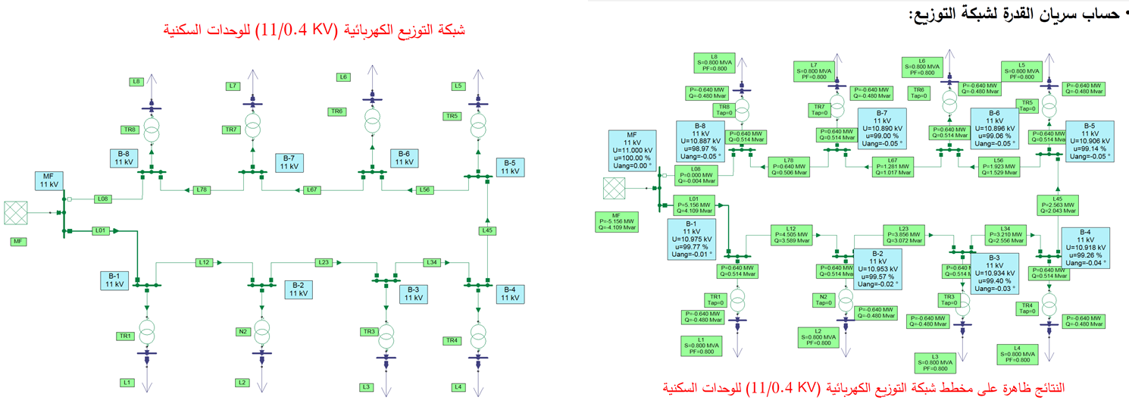
Research
Study of NEPLAN Software for Power Flow and Short Faults Analysis
https://www.researchgate.net/publication/277110587_Study_of_NEPLAN_Software_for_Load_Flow_and_Short_Faults_Analysis/stats
B.Tech Project, 2008 at College of Industrial Technology, Misurata, Libya
Advisor: Mohamed Shetwan
Acquired Expertise: Teaching, Tutorials, Lab Modeling & Simulations, Curriculum Revision & Prepartion, Dedication, Listening, "Try to Modeling the Student’s Way of Thinking.”
Software Tools including: MS Office, MATLAB, NEPLAN, PLC’s Ladder Logic

Slide 11

Research
SMART GRID, Seminar
https://www.slideshare.net/MohamedAbuella/smart-grid-37661484
Smart Grid Presentation in Seminar Course, 2012 at Southern Illinois University at Carbondale
Study of particle swarm for optimal power flow in IEEE benchmark systems including wind power generators
https://www.proquest.com/openview/21da3b4335a4c23278e9bd91d67a7784/1?pq-origsite=gscholar&cbl=18750
Master of Science Thesis, 2012 at Southern Illinois University at Carbondale, USA
Advisor: Constantine Hatziadoniu
Acquired Expertise: Power Systems Analysis, Operation and Planning, Systems Optimization, Smart Grid, Research Conducting, Software Tools: MATPOWER, PowerWorld, PSAT, LaTeX

Slide 12

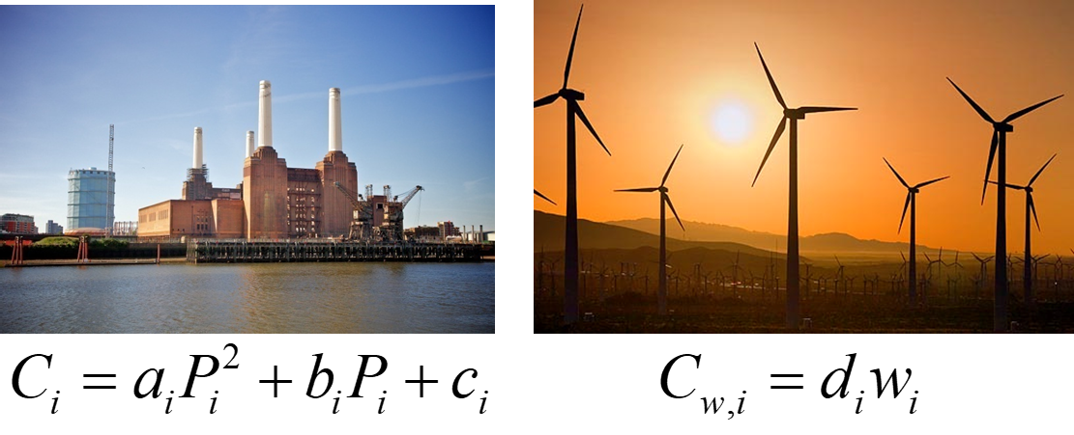
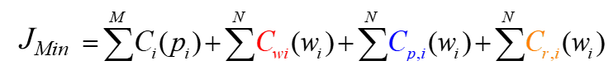
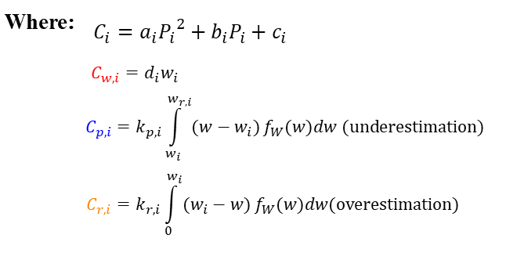
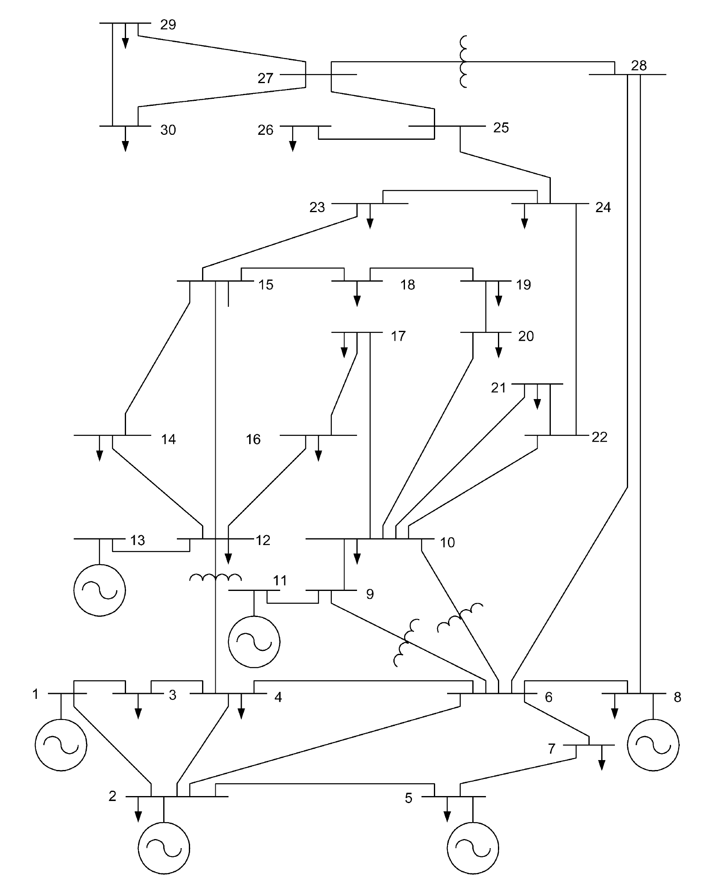
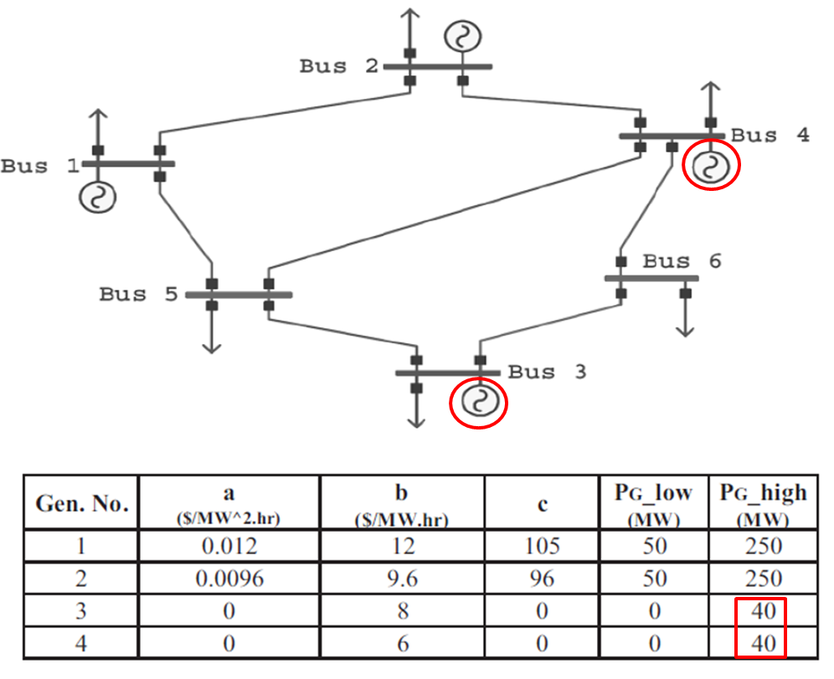
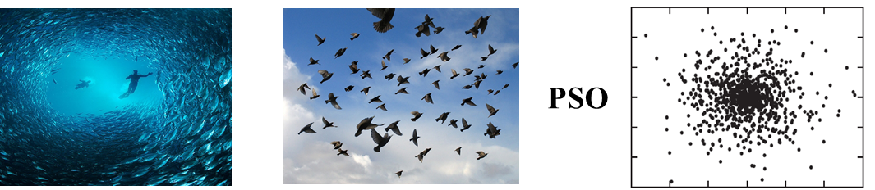

Research
Study of particle swarm for optimal power flow in IEEE benchmark systems including wind power generators
https://www.proquest.com/openview/21da3b4335a4c23278e9bd91d67a7784/1?pq-origsite=gscholar&cbl=18750
Master of Science Thesis, 2012 at Southern Illinois University at Carbondale, USA
Advisor: Constantine Hatziadoniu
Particle Swarm Optimization (PSO) algorithm is used for solving this optimization problem.

Slide 13
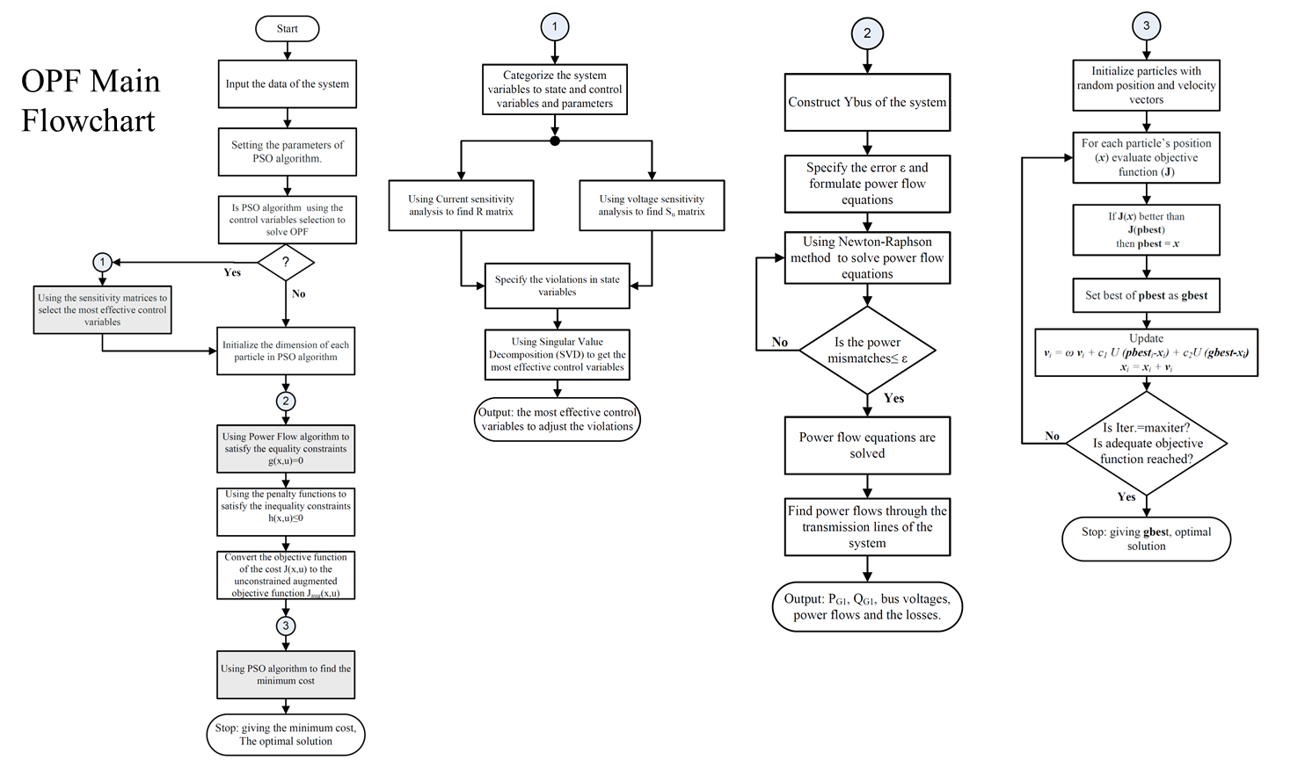
Research
Study of particle swarm for optimal power flow in IEEE benchmark systems including wind power generators

Slide 14

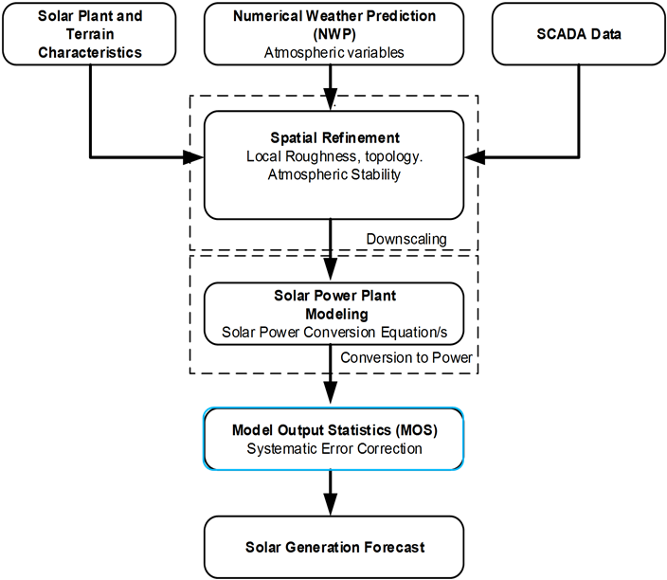
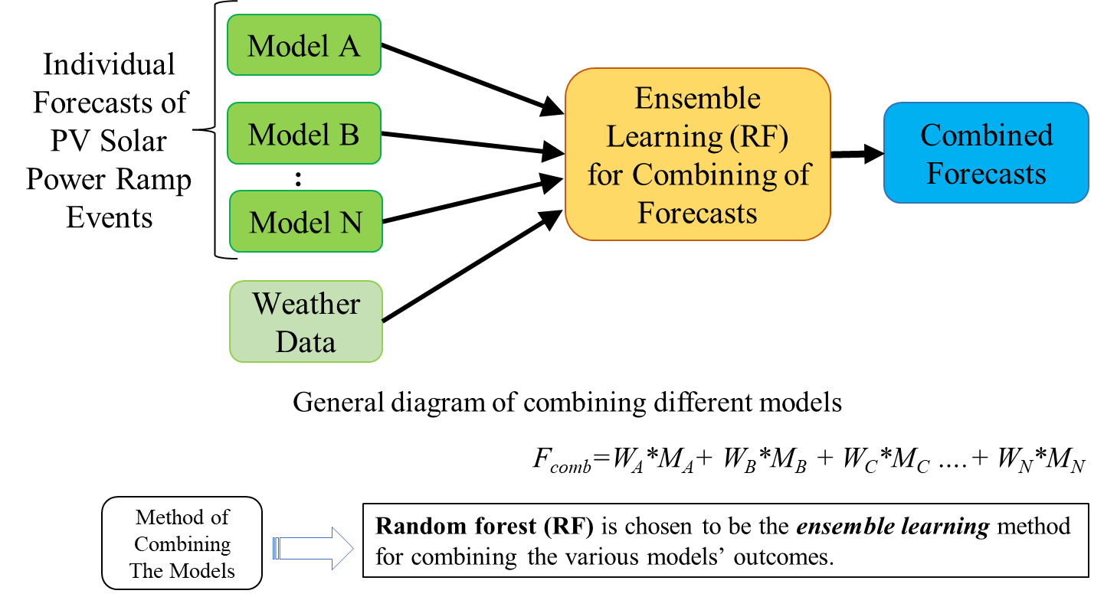
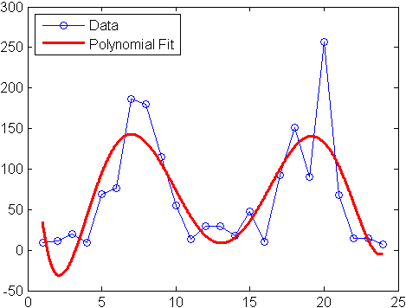
Research
A Post-Processing Approach for Solar Power Combined Forecasts of Ramp Events
https://www.proquest.com/openview/42049145119c7760f93ea736b37a0930/1.pdf?pq-origsite=gscholar&cbl=18750
PhD Thesis, 2018 at University of North Carolina at Charlotte, USA
Advisor: Badrul Chowdhury
Acquired Expertise: Energy Analytics, Energy Markets, Renewable Energy Integration, Asset & Supply Chain, Time Series Analysis & Modeling, Risk & Uncertainty Quantification, Machine Learning, Big-Data Processing, Research Publishing & Peer Reviewing, Software Tools including SAS, R, and Python

Slide 15

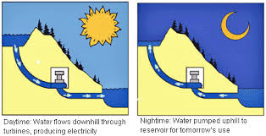


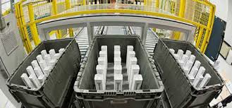

Research
Why Forecast?
P_{Supply} = P_{Demand} +P_{Loss}
PV Solar Power Generations
are Too Variable
Coordination with Operating Reserves and Energy Storage
Systems
Reducing
Cost
and Pollution
Illustration of the motivation of PV solar power forecasts

Slide 16
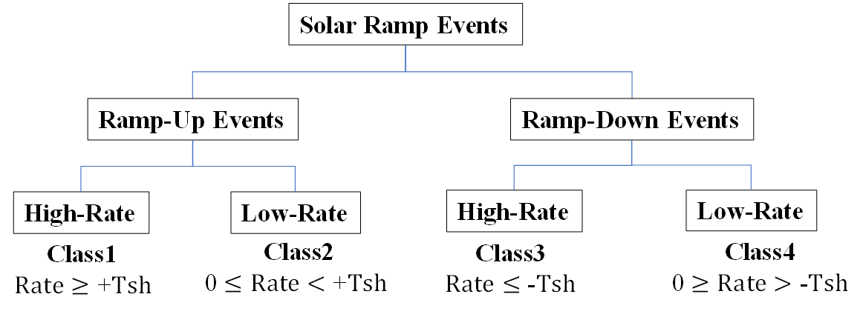
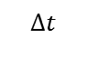
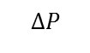
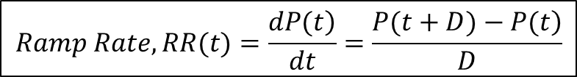
Research
Definition of Ramp Events
Solar power ramp rate (RR) is the change of solar power during a certain time interval.
$$Ramp Rate, RR(t)=\frac{\left.dP(t\right)}{dt}=\frac{\left.P(t+D)−P(t\right)}{D}$$
$$ΔP$$
where P(t) is the solar power of the target hour, it can also be its forecast F(t); D is the time duration for which the ramp rate is determined.
For the illustrated cloudy day below:
$$Δt$$
Ramp rate, $\frac{ΔP}{Δt}$ = $\frac{0.2−0.85}{12:00−11:00}=−0.65 \left(−65\%\right) ramp down of its normal capacity, (pu/hr)$
Ramp rate, $\frac{ΔP}{Δt}$ = $\frac{0.48−0.1}{14:00−13:00}=+0.38 \left(+38\%\right) ramp up of its normal capacity, (pu/hr)$
Some ramps are with low rates, while others with high rates.
Distribution of the classes of solar power ramp events
Ramp Events During a Cloudy Day

Slide 17
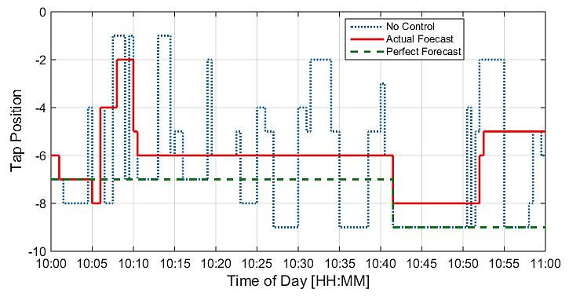
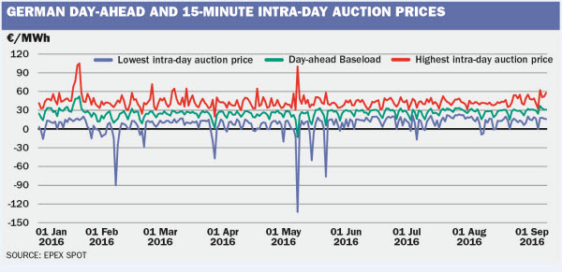
Research
Potential Applications
There are several applications of power systems that rely on solar power ramp event forecasts
Distribution level:
Optimizing the voltage regulation equipment.
Control schemes of energy storage systems.
Optimizing the Transformer's Tap Changer position sequences using the solar forecast
Transmission / bulk level:
Trading & dispatching the operating reserve.
Managing the ramp capability / system flexibility with high-level of renewable energy integration.
EPEX: European power exchange spot trading

Slide 18
Research
Flowchart of Solar Power Forecasts
Block diagram of the adjusting approach

Slide 19
Research
Combined forecasts of solar power for cloudy days before and after applying the adjusting

Slide 20
Research
Graphs of the probabilistic forecasts of the three methods for three days

Slide 21
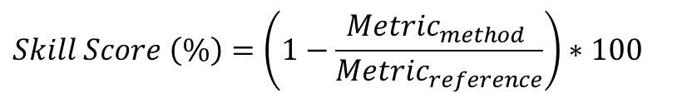
Research
Before Adjusting Analog Ensemble
$$Skill Score \left(\%\right)=\left(1−\frac{{Metric}_{method} }{{Metric}_{reference}}\right)∗100$$
Average Improvement of the Adjusting Approach:
51% over Persistence;
16% over Analog Ensemble;
15% over Ensemble.

Slide 22
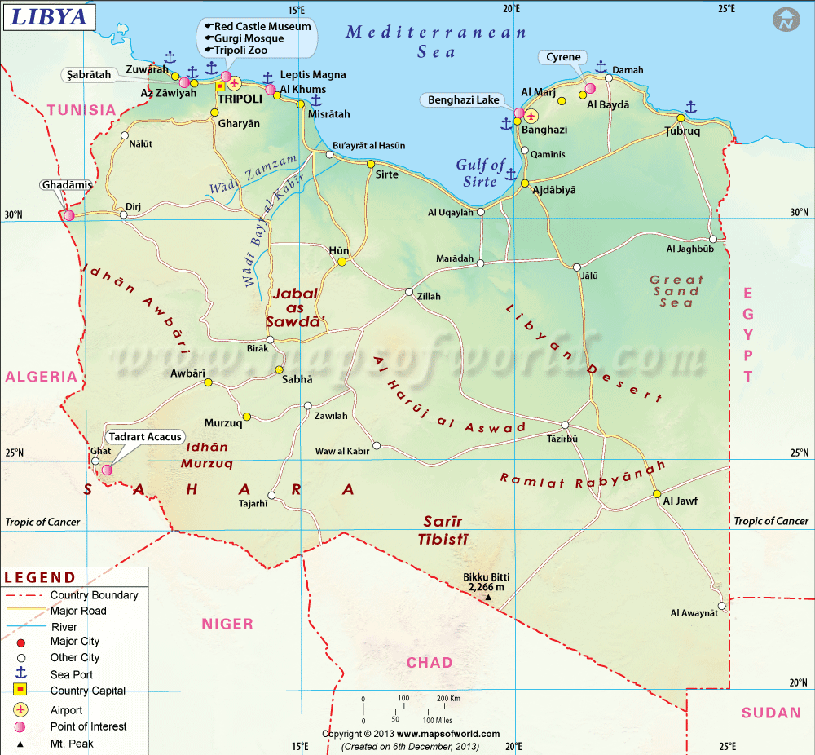
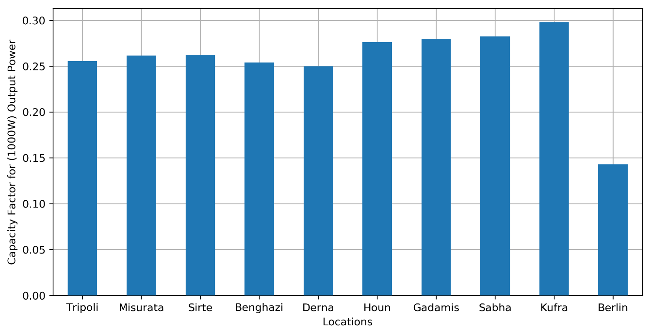
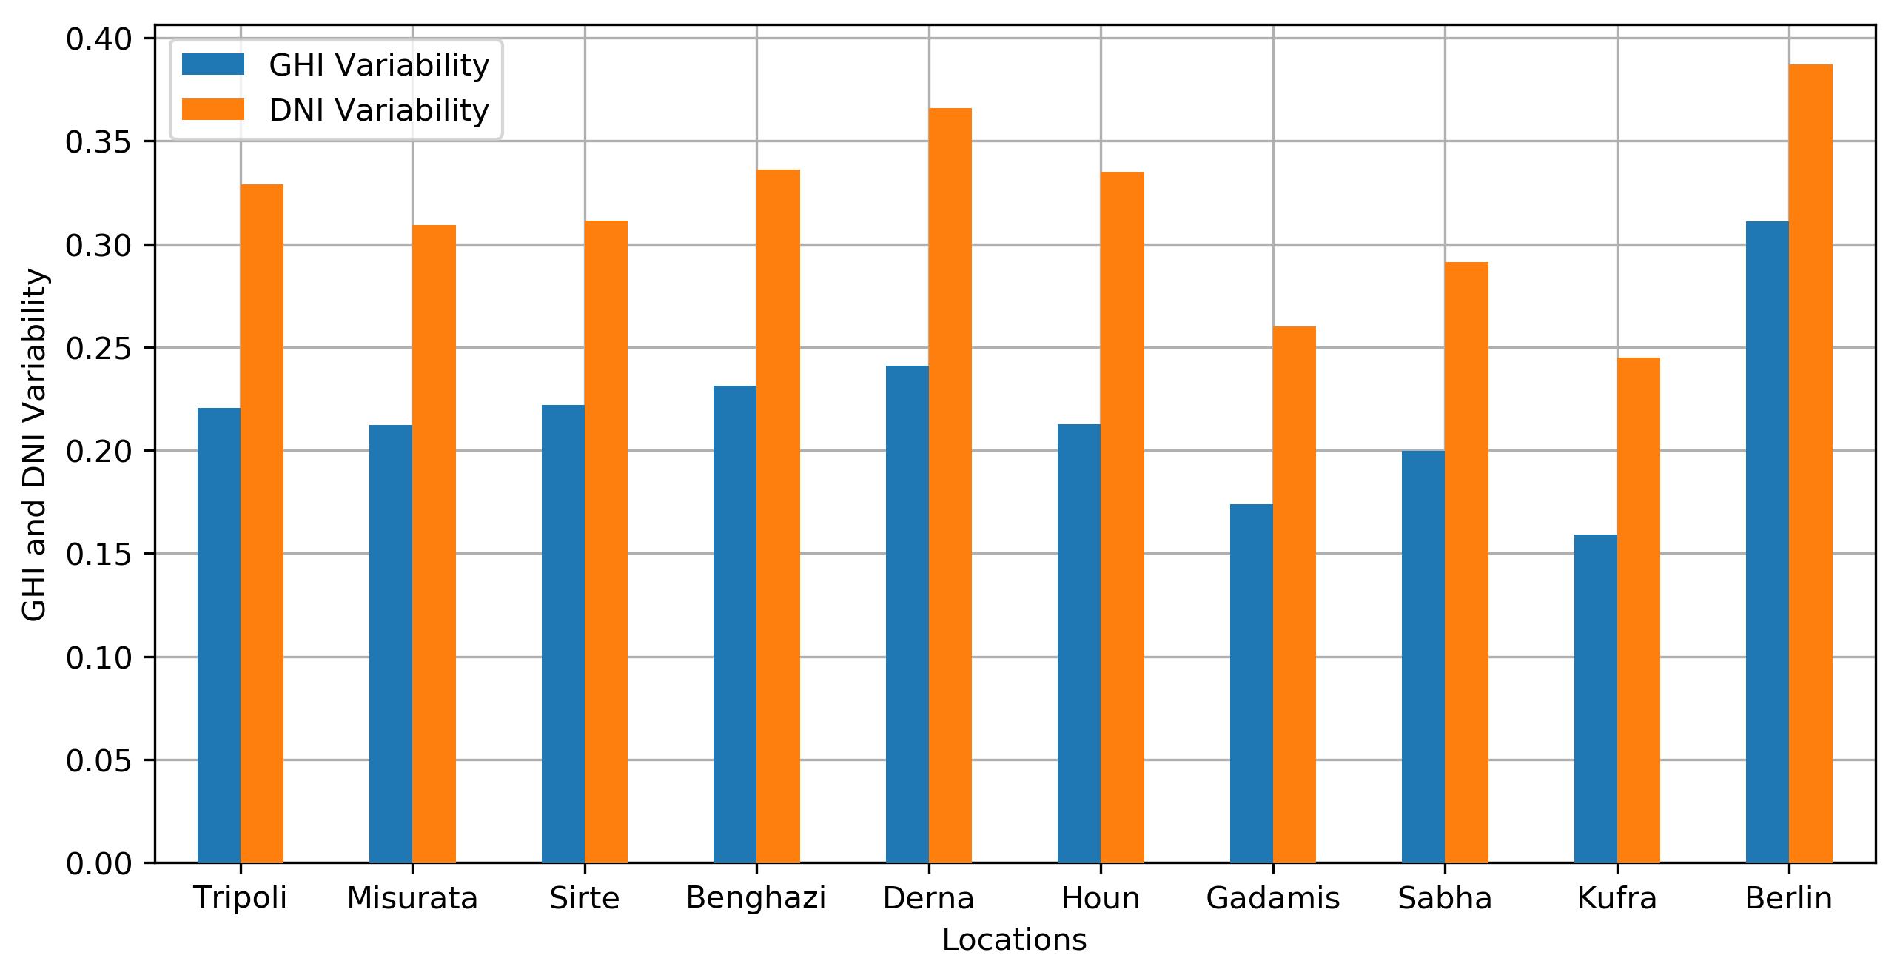
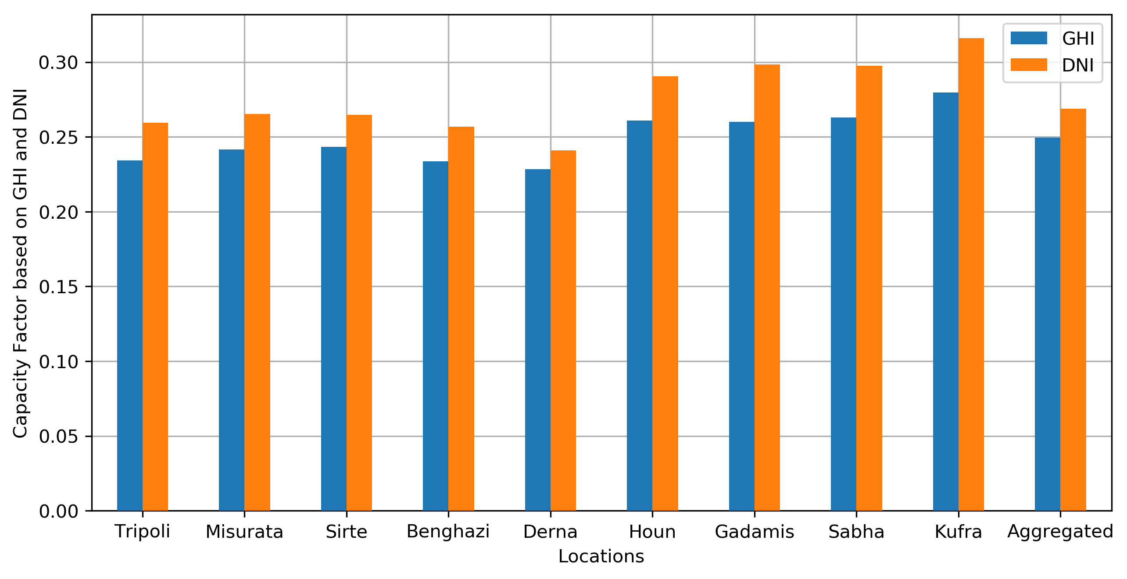
Research
Planning and Analysis for Solar Energy in Libya
9 Locations for Comparison of Solar Energy Modeling and Analysis: Tripoli, Misurata, Sirte, Benghazi, Derna, Houn, Gadamis, Sebha, Kufra
Typical Meteorological Year (TMY) data represents the weather for a "median year”. https://developer.nrel.gov/
The Capacity Factor is calculated based on output power (PWac).
The Rating of Solar PV System =1000W during an entire year = 8760 hours.

Slide 23
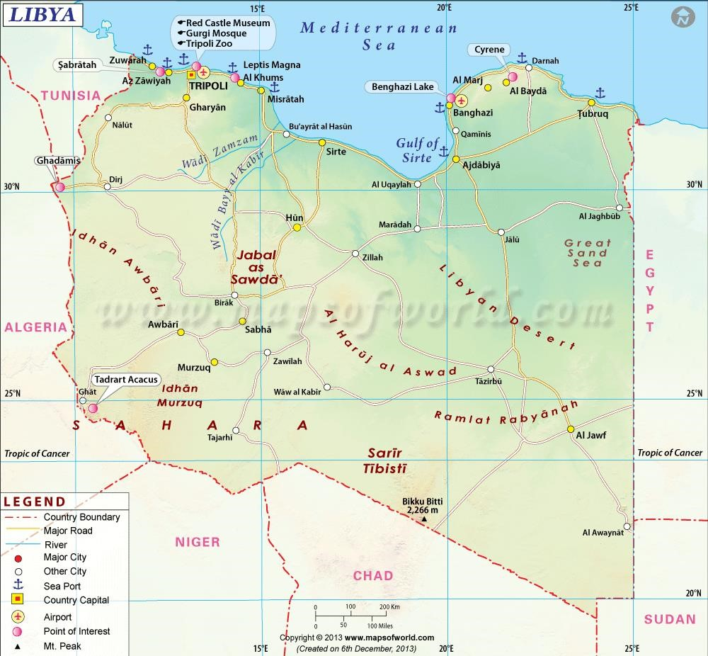
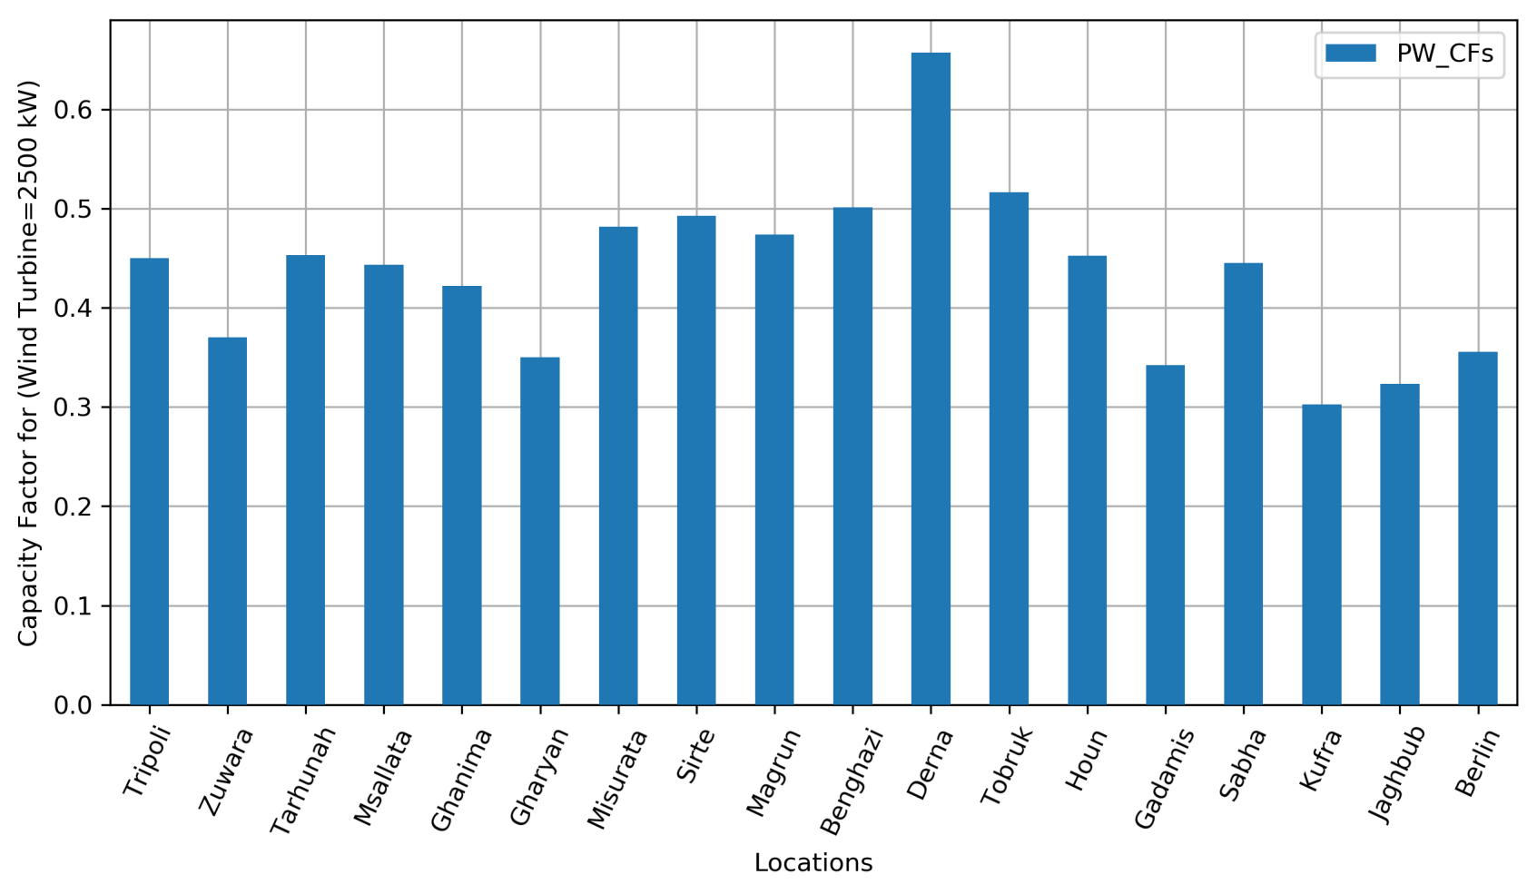
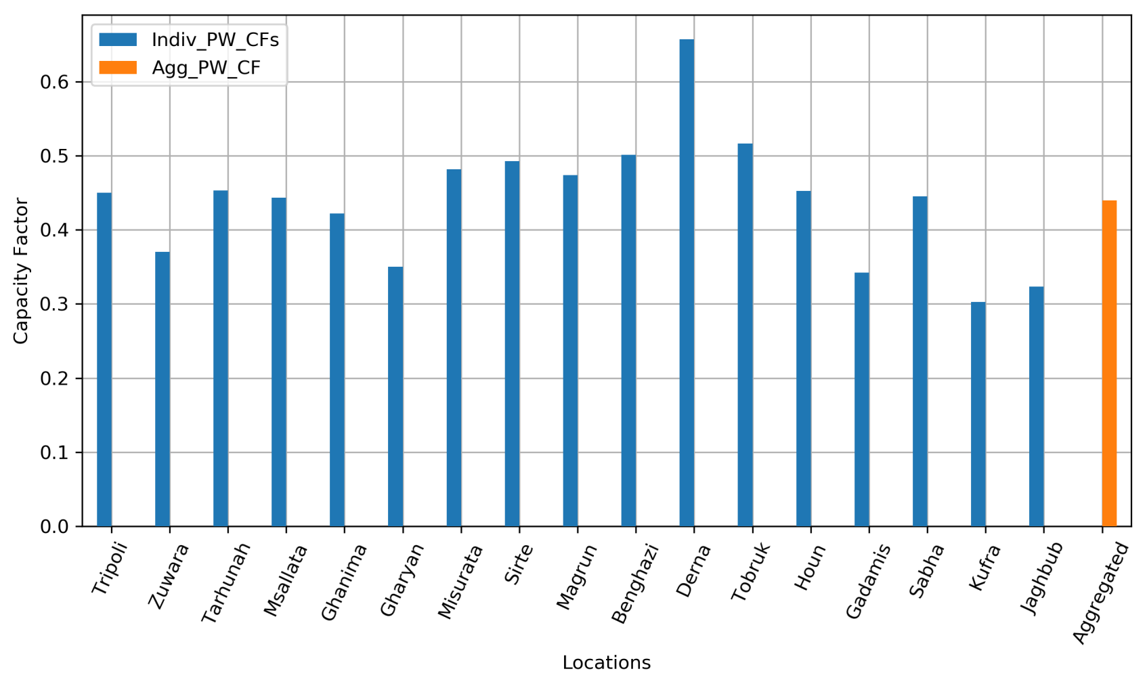
Research
Planning and Analysis for Wind Energy in Libya
17 Locs: Tripoli, Misurata, Tarhunah, Ghanima, Msallata, Zuwara, Gharyan, Sirte, Benghazi,Magrun, Derna, Houn, Gadamis, Sabha, Kufra, Tobruk, Jaghbub
Typical Meteorological Year (TMY) data represents the weather for a "median year”. Data are retrieved from NREL’s Developer Network: https://developer.nrel.gov/ Comparison of Monthly Average Wind Speed (m/s) at Height of 10m
The Capacity Factor is calculated based on Output power (PWac).
The Rating of Solar PV System =1000W during an entire year = 8760 hours.
Berlin in Germany has been added just for sake of comparison.

Slide 24
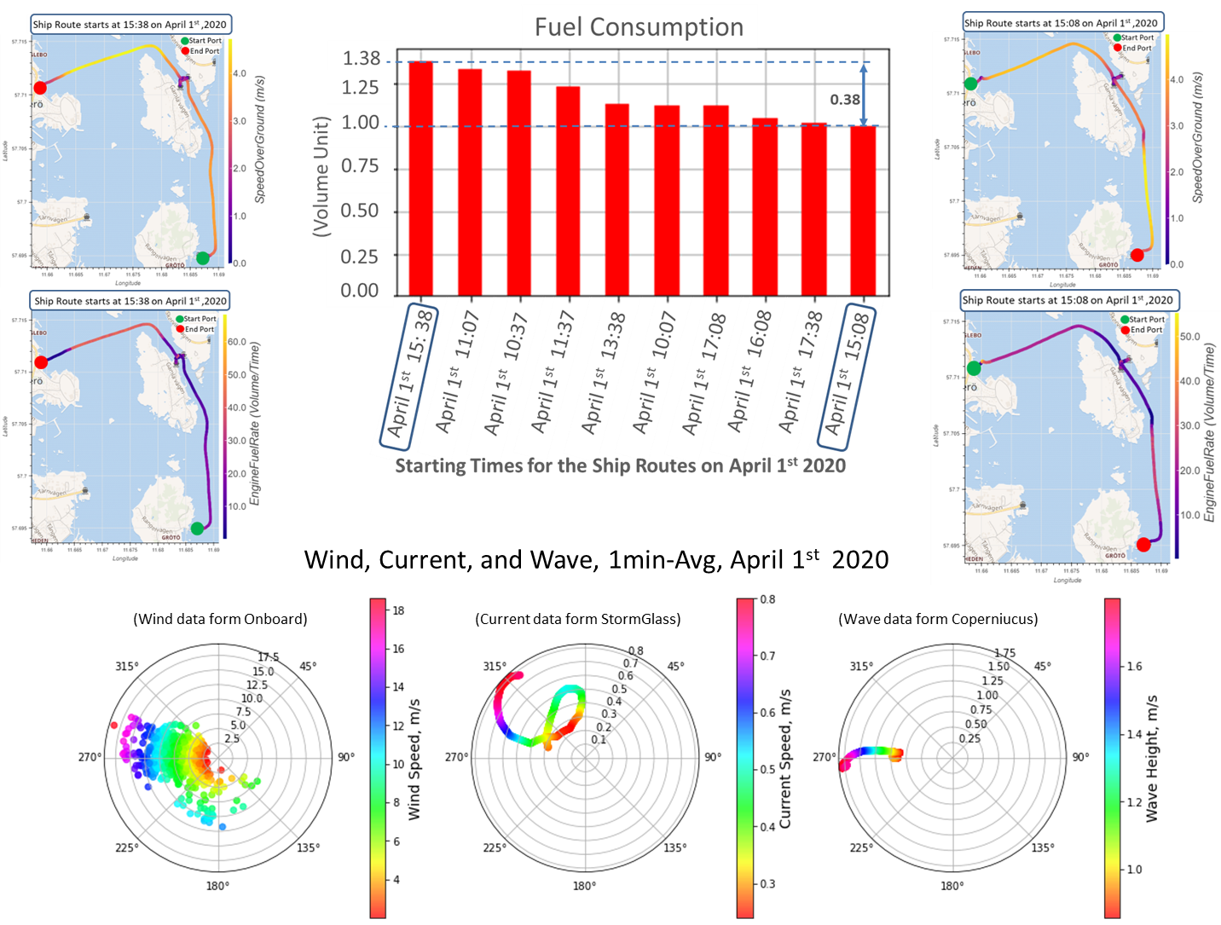
Research
Research Work for Improving the Vessel’s Energy Efficiency

Slide 25
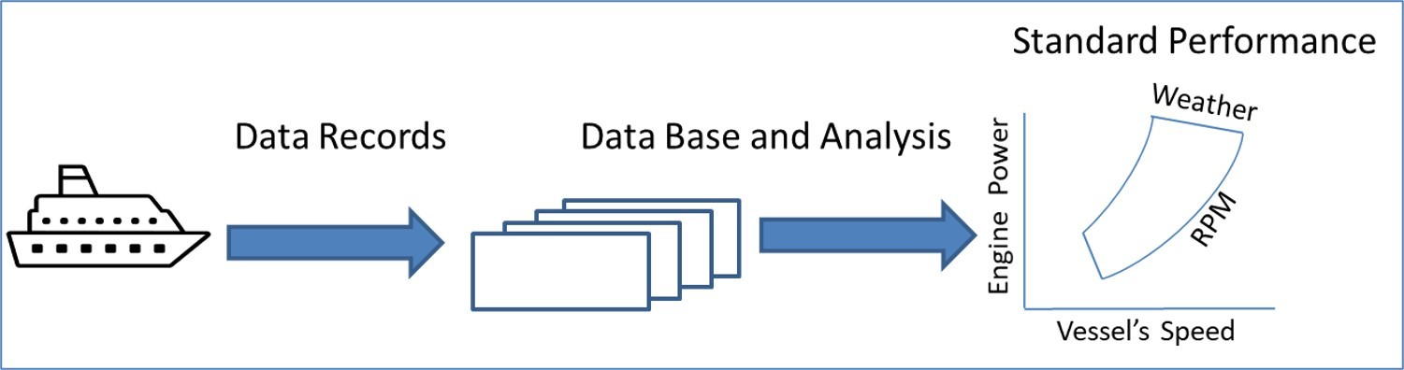
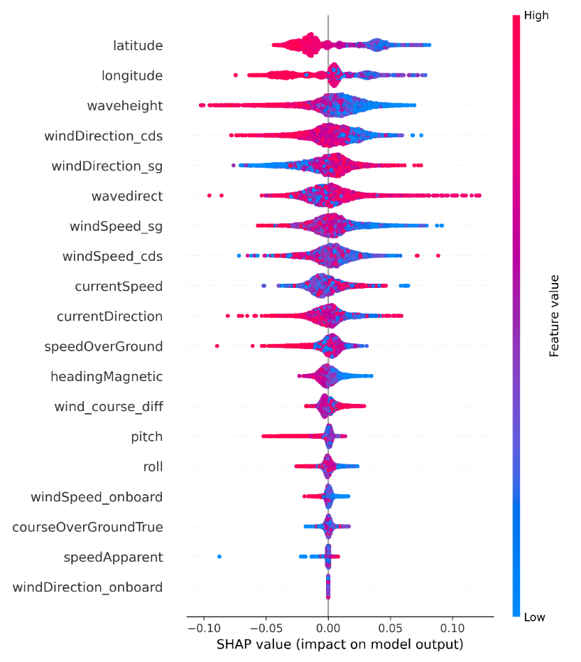
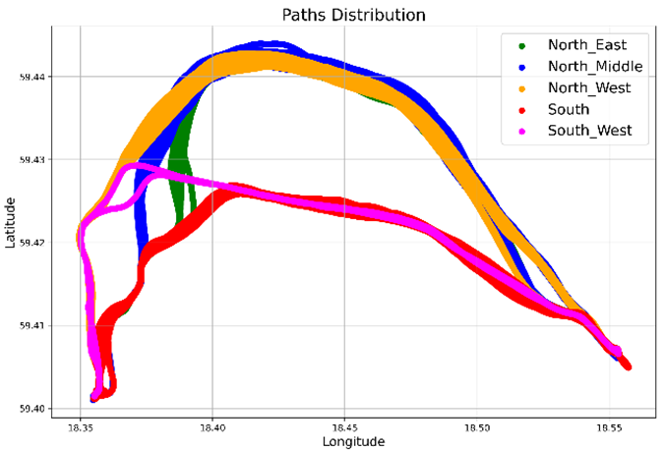
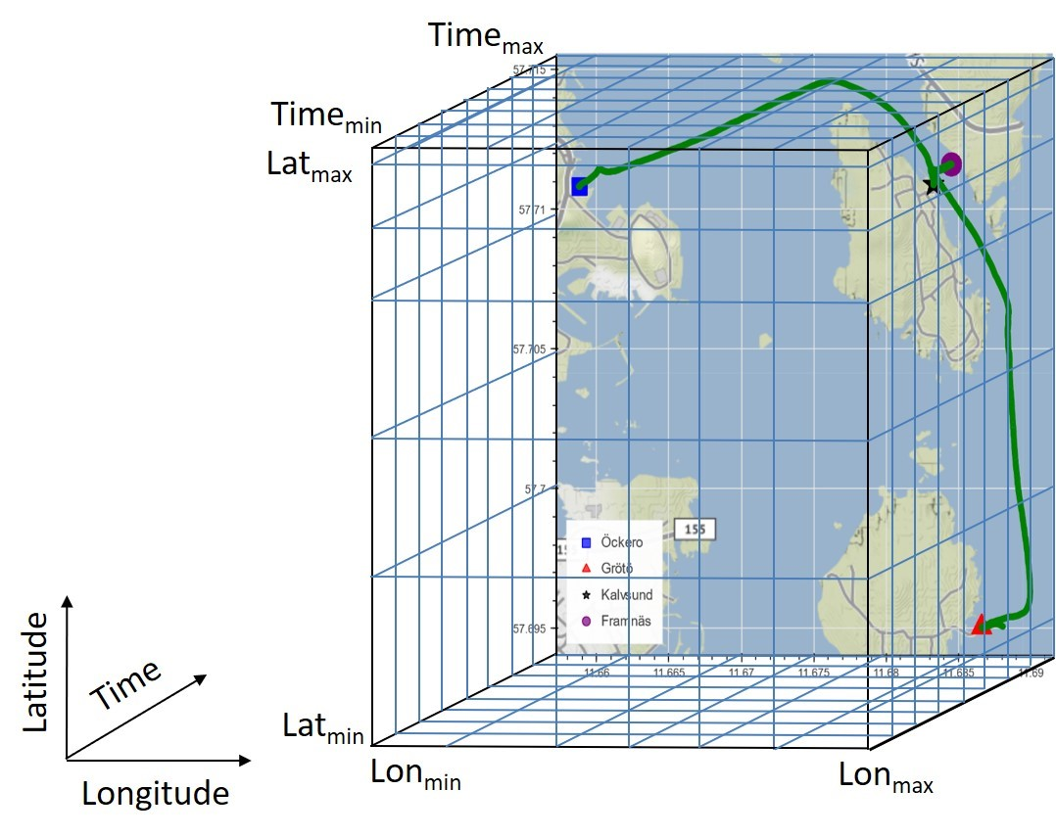
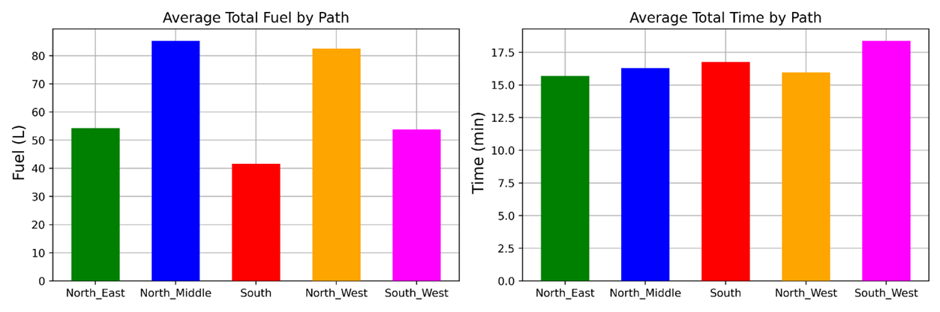
Research
Data Analytics for Improving the Vessel’s Energy Efficiency
Descriptive Modeling
Input: Data of vessel’s operational and environmental data, from onboard and external sources.
Second step (One ANN)
Predictive Modeling
Input: Preprocessed data include operating and weather variables, such as vessel’s speed and course, wind, wave, current, etc.
Prescriptive Modeling
Input: Using solving algorithms, with control variables, such as vessel’s speed and course, to find the optimal fuel and time.
Outcome: Dataset for training and validation the predictive and prescriptive models.
Outcome: Validated predictive models for fuel, distance and time.
Outcome: Improving fuel consumption and meeting the operational conditions

Slide 26



Research
Workflow of Applying XAI for Improving the Vessel’s Energy Efficiency
Data
Collection
Data Preprocessing
and Validation
Representation of Vessel’s Routes by Fuel & Time
Efficiency Score
Calculation
Normalize the Fuel and Time for each route with respect to the maximum Fuel and Time of all routes.
Then, the Efficiency Score is calculated for each route.
Spatio-Temporal Aggregation
Aggregate the vessel’s routes in terms of
Total Fuel and Total Time
Resampling
Averaging in Time
(1min.)
EngineFuelRate and Timestamps
Vessel’s onboard data
.
Onboard Operational and Weather Data
External
Weather
Data
Output Case (1) EngineFuelRate
Output Case (2)
Total Fuel
Output Case (3) Efficiency Score
Data Validation
Variables
Exchange
Between XAI and ANN
XAI Technique: Shapley Values
Model: XGB
Inputs: Operational and weather variables
Output Case (1) EngineFuelRate
Output Case (2)
Total Fuel
Output Case (3) Efficiency Score
ANN Input Selection
Operational and weather variables to prepare 4 cases of ANN inputs
Inputs Case I
ANN Regression Model
Interpolation
In Time (1min.) and Space with vessel’s position
Inputs Case II
External weather data
Output: (1) EngineFuelRate, (2) Total Fuel, or (3) Efficiency Score
Inputs: Different combinations of inputs (inputs cases I - IV)
ANN parameters are tuned for each of outputs and inputs cases
Inputs Case III
Inputs Case IV

Slide 27

Research
Predictive Analytics
Shapely values for Regression of Eff-Score (Global, where Fuel and Time are normalized based on values of all routes)
The spatio-temporal aggregation and using the efficiency score (Global) leads to the Causality

Slide 28
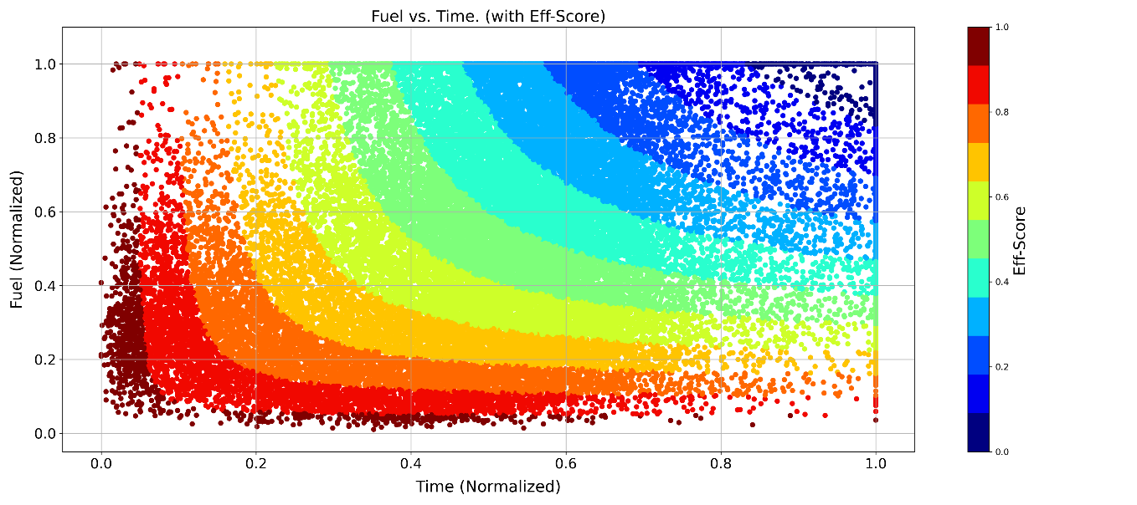
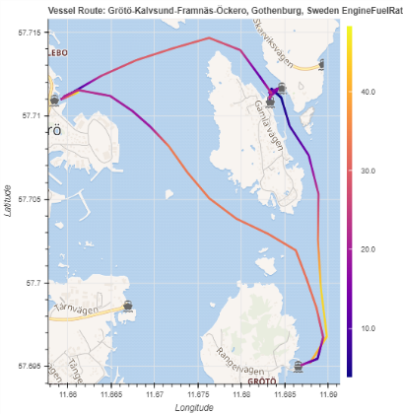
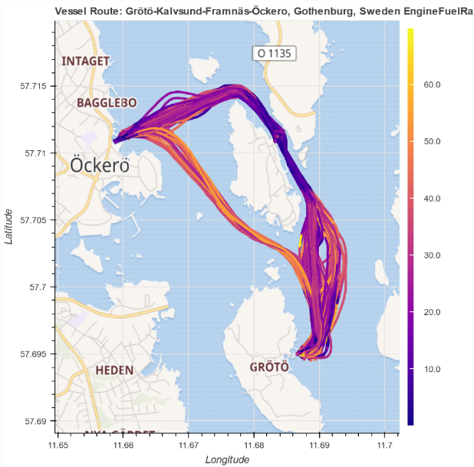
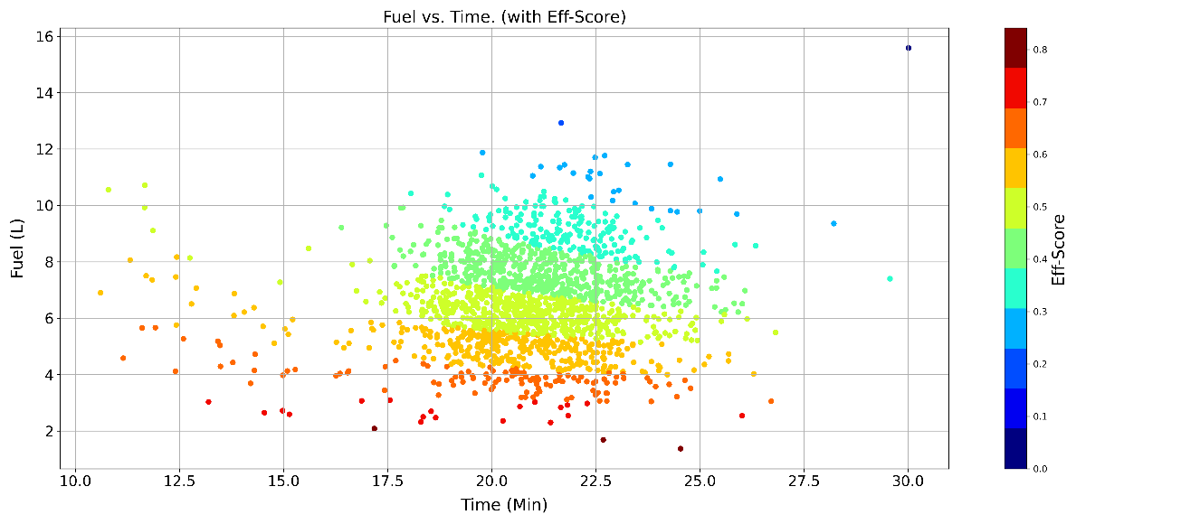

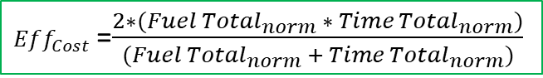
Research
Effeciency Score
It is calculated once for the entire route.
Predictive Analytics
EngineFuelRate (L/H)
EngineFuelRate (L/H)
1754 sequences (Routes)
$Eff_{Cost}$=$\frac{2∗(Fue{l Total}_{norm} ∗{ Time Total}_{norm})}{(Fue{l Total}_{norm} +{ Time Total}_{norm})}$
$${Eff}_{score}=1−Eff_{Cost}$$

Slide 29

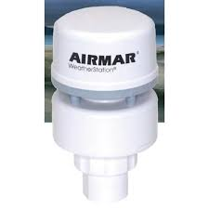


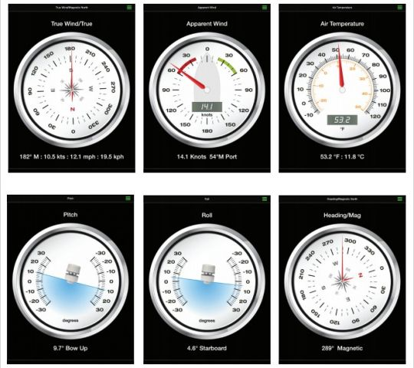
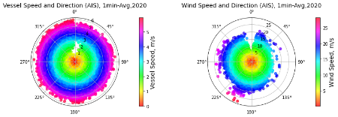
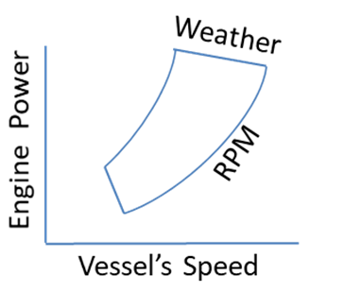
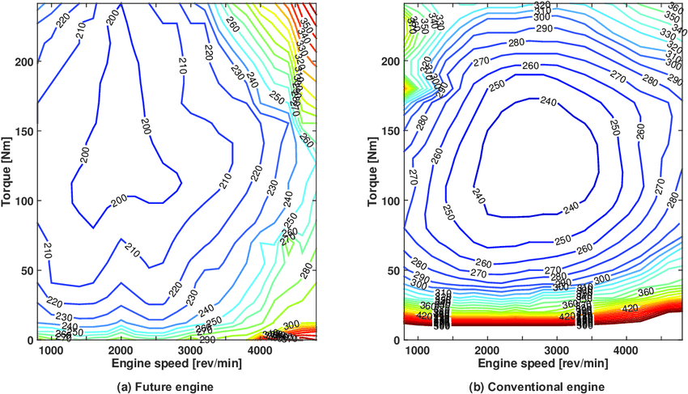
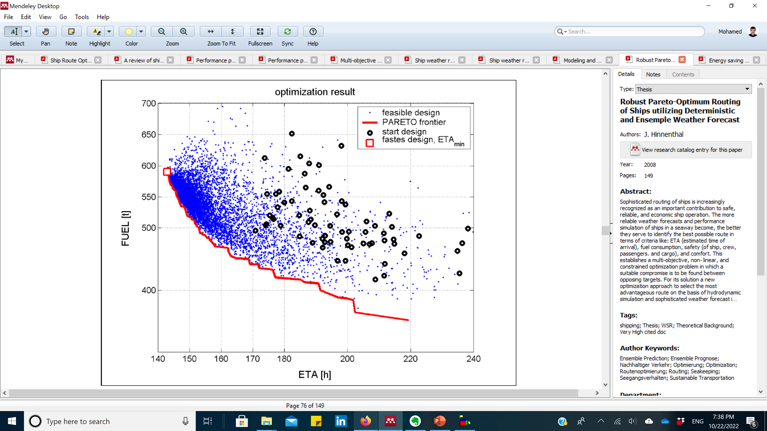
Research
Problem Formulation
Objective Function:
Minimizing the fuel consumption
Solutions Finding
Solving algorithm:
Modeling and managing the engine power at any weather conditions by using a fuel estimation model
Control variables:
Ship’s speed and course
Constraints:
Arrival time, geographic, safety, route smoothness, the ship’s roll, and the engine power
Objective:
Minimum fuel consumption

Slide 30
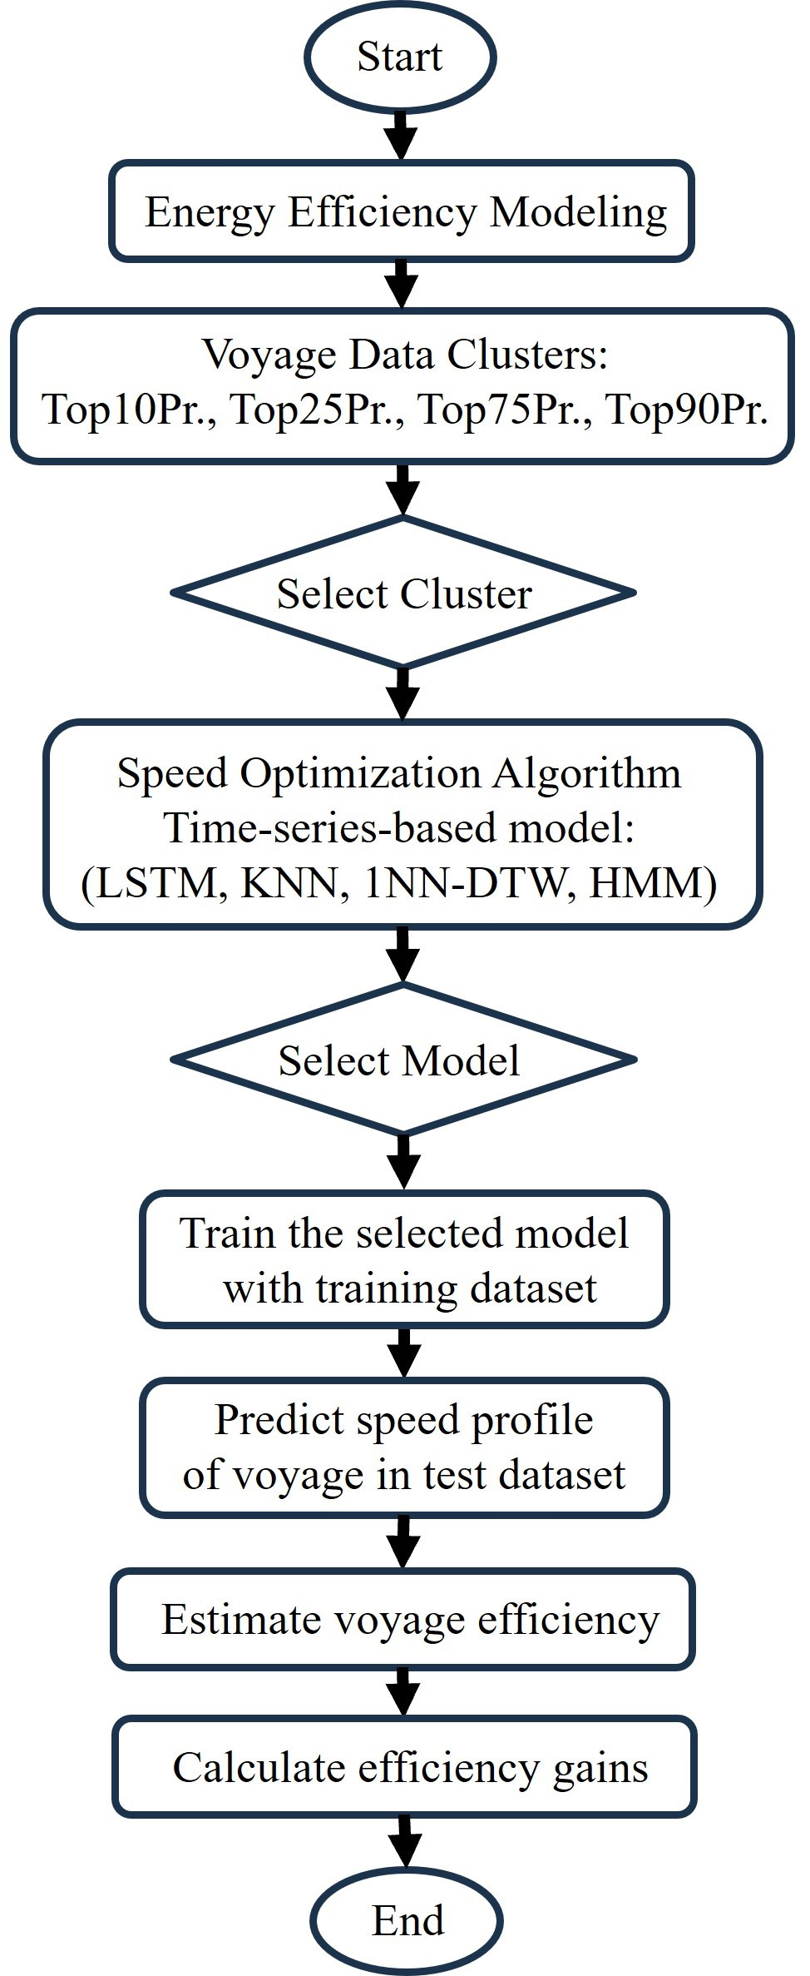
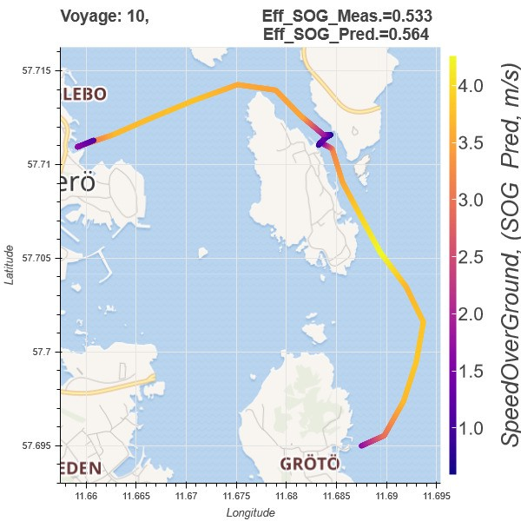
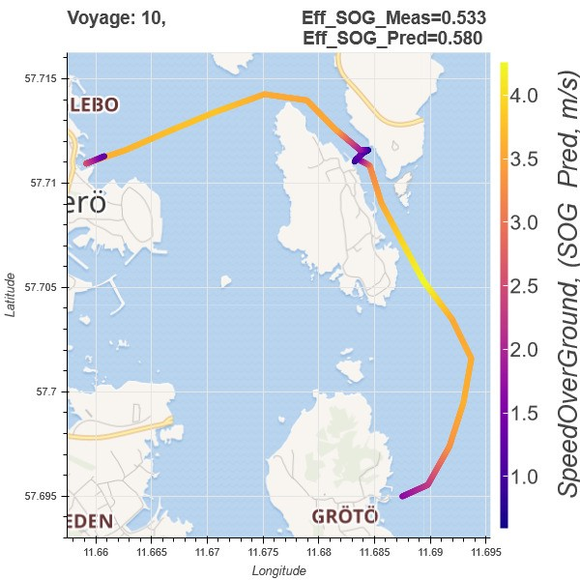


Research
Predictive Analytics
Framework of vessel voyage optimization
(a) LSTM-based model (b) KNN-based model
(c) 1NN-DTW-based model (d) HMM-based model
Cluster | Efficiency Score | LSTM | KNN | 1NN-DTW | HMM
Top10Pr | Eff. Gains (%) IV Count (#) | 2.61 134 | 2.13 114 | 3.20 127 | 6.05 139
Top25Pr | Eff. Gains (%) IV Count (#) | 2.38 129 | 1.58 107 | 3.23 128 | 1.30 107
Top50Pr | Eff. Gains (%) IV Count (#) | 0.97 100 | 0.98 106 | 2.58 117 | 7.34 140
Top75Pr | Eff. Gains (%) IV Count (#) | -0.84 60 | 0.50 93 | 2.28 119 | 9.31 141
Average | Eff. Gains (%) IV Count (#) | 1.28 105.75 | 1.30 105.00 | 2.82 122.75 | 6.00 131.75
where,
Counts of improved voyages (IV Count#) out of 162 voyages in the test dataset

Slide 31




Path Planning
Research
Spatial Clustering Approach for Vessel Path Identification
The vessel route
(a)
(b)
Framework of vessel path identification.
(a) Flowchart of distance-based method.
(b) Flowchart of segmented Gaussian likelihood method.

Slide 32







Research
Multi-Energy Model
HI ACT: Hydrogen Integration for Accelerated Energy Transitions
Schematic Diagram
The set of equations was solved by using two Python packages:
1-Pandapower for power network
2-Pandapipes for gas network
Framework for the Multi-Energy System
H2_prop | Total_cost | Optimal_q_e | Optimal_q_g | qg_H2 | qg_gas | H2_mdot | Gas_mdot | Source_mdot
 | (£) | (MWh) | (MWh) | (MWh) | (MWh) | (kg/s) | (kg/s) | (kg/s)
0 | 10442.183 | 308.507 | 2.219 | 0.000 | 2.219 | 0.000 | 0.152 | 0.152
0.1 | 10442.671 | 308.507 | 2.269 | 0.080 | 2.190 | 0.002 | 0.150 | 0.152
0.2 | 10443.262 | 308.507 | 2.330 | 0.176 | 2.154 | 0.004 | 0.147 | 0.152
0.3 | 10443.994 | 308.507 | 2.405 | 0.296 | 2.110 | 0.008 | 0.144 | 0.152
0.4 | 10444.925 | 308.507 | 2.501 | 0.448 | 2.053 | 0.011 | 0.140 | 0.152
0.5 | 10446.147 | 308.507 | 2.627 | 0.648 | 1.979 | 0.016 | 0.135 | 0.152
0.6 | 10447.824 | 308.507 | 2.799 | 0.922 | 1.877 | 0.023 | 0.128 | 0.152
0.7 | 10450.266 | 308.507 | 3.050 | 1.321 | 1.729 | 0.034 | 0.118 | 0.152
0.8 | 10454.152 | 308.507 | 3.450 | 1.956 | 1.494 | 0.050 | 0.102 | 0.152
0.9 | 10461.302 | 308.507 | 4.184 | 3.124 | 1.061 | 0.079 | 0.073 | 0.152
1 | 10478.799 | 308.507 | 5.983 | 5.983 | 0.000 | 0.152 | 0.000 | 0.152
Power Network
Gas Network
32

Slide 33





Research
GB’s National-Scale Multi-Energy Model
HI ACT: Hydrogen Integration for Accelerated Energy Transitions
The GB’s energy system: Electricity and gas networks have been built using pandapower and pandapipes in Python.
Integrated multi-vector energy system framework
Electricity Network
Gas/Hydrogen Network
Flowchart for Short-term operation
& long-term planning
33

Slide 34

Research (Miscellaneous)
Some other Projects in GitHub: https://github.com/mhdella?tab=projects

Slide 35
Research (Miscellaneous)
Keep up some blogs on : https://mohamedabuella.github.io/blog/
Blogs
09 Jun 2025 » Blog Interactive Levelized Cost of Thermal Energy (LCOT) Calculator
06 May 2025 » Blog Decarbonizing Residential Heating in the North of Tyne
06 Apr 2025 » Blog Interactive Tool for Long-Term Planning of Different Energy Assets
04 Apr 2025 » Blog Profit Allocation in a Simple Energy System Using Cooperative Game Theory
05 Oct 2024 » Blog Hydrogen Blending for Sustainable Energy: A Case Study in the North of Tyne Region
01 Jun 2024 » Blog Hydrogen Integration: Lessons from Solar Energy Integration
24 Mar 2024 » Blog iHelm Project: Data Analytics for Improving Energy Efficiency in Short Sea Shipping
05 Feb 2024 » Blog Tools for Energy Systems Modeling and Analysis
23 Dec 2023 » Blog Systematic Analysis of Mendeley Documents with ChatGPT as a Coding Utility
06 Dec 2023 » Blog iHelm Project: Data Analytics for Improving Energy Efficiency in Short Sea Shipping
06 Dec 2023 » Blog Data Analytics for Vessel Path Planning in Short-Sea Shipping
06 Dec 2023 » Blog Data Analytics for Improving Energy Efficiency in Short-Sea Shipping
15 Dec 2021 » Blog Using pandapower for Modeling and Analysis of Energy Systems
01 Sep 2021 » Blog Planning and Analysis for Wind Energy in Libya
19 Jul 2021 » Blog Planning and Analysis for Solar Energy in Libya
11 Dec 2019 » Blog Reading and Reflection on a Book of Solar Energy
19 Aug 2019 » Blog Does the Educational Curricula Keep the Pace with the Advancements in Energy ..?
09 Aug 2019 » Blog Wind and Solar Energy Resources Modeling and Analysis
30 Jul 2019 » Blog Net Load Forecasting for Microgrid Resiliency
29 Jul 2019 » Blog How a Subtle Lack of Knowledge Could Lead to Catastrophic Consequences
23 Jun 2019 » Blog Reading a Big-picture Book after a While of Focusing on Elaborate Technical Stuff
17 Jun 2019 » website Website Launched

Slide 36

Research (Miscellaneous)
Power System Flexibility and DG resources management, I have been working on Forecasting and Machine Learning approaches, since 2014
Techno-economic analysis of HOMER, NREL SAM, and PVLib Toolbox for Python.
Writing using Latex (Eqs, Biblio.), Mendeley (~14000 docs, tags), Evernote (organize notes, share them), Dropbox, Google Drive (clouds to back up), iCalendar, etc.
Research Outreach and Knowledge Dissemination: depending extensively on the online tools, such as Blogs on personal website, LinkedIn, Twitter, Researchgate, Newsletter from relevant groups of interest (ESIG, AI in Smart Grids, ISES, WEMC, etc.)
Review of IEEE Transactions on Sustainable Energy

Slide 37
Thanks for Your Listening
Any Question?
Mohamed Ali Abuella
mhdabuella@gmail.com

